Slide 1
In Partnership with

Slide 2
Collection Service Overview

Slide 3
Hybrid Approach
The tenacity of a collection agency,
the power of a nationally-reaching law firm

Slide 4
Allied
National
Inc.
Law Firm

Slide 5
Key Elements of our Strategy
Persistence, experience, and diligence – an in-house team of seasoned collectors and attorneys, working for your bottom line.
Urgency - all letters are sent on Cohn & Dussi letterhead, all phone calls begin with the introduction of our law firm to your debtor.
National litigation collaborative - one office for 50 states, from placement all the way through litigation.
Transparency – via our user-friendly, state-of-the-art monitoring and reporting platform, CLUES (Client Update & Entry System)

Slide 6
The Life of a Claim
We can shepherd your claim from initial placement all the way through litigation – anywhere in the US.

Slide 7
Client Update and Entry System (CLUES)
100% transparency into all collection & litigation efforts
Secure, backed up several times each day
Accessible from any web connection, 24/7
Valuable reporting tools
Two-way communication
Takes Monitoring and Reporting off your desk
Solves time zone conflicts
Provides a true, honest audit trail of all activity – you
can be confident that we’re always operating in your
best interest.

Slide 8
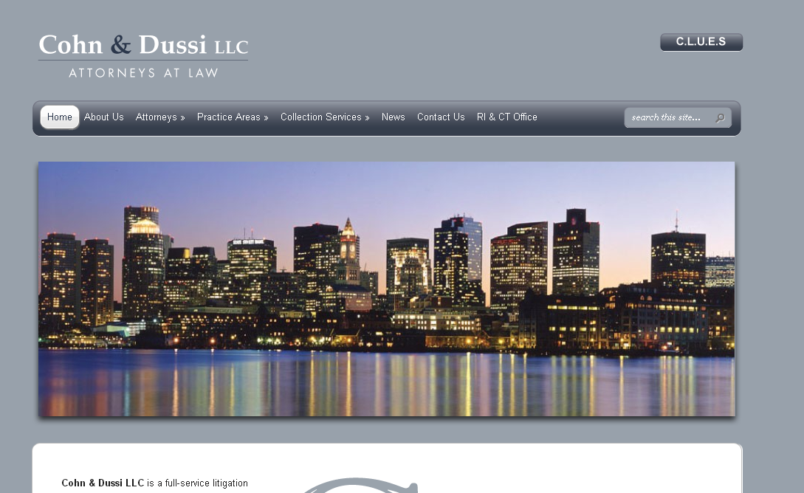
Easy accessibility from http://cohnanddussi.com/

Slide 9
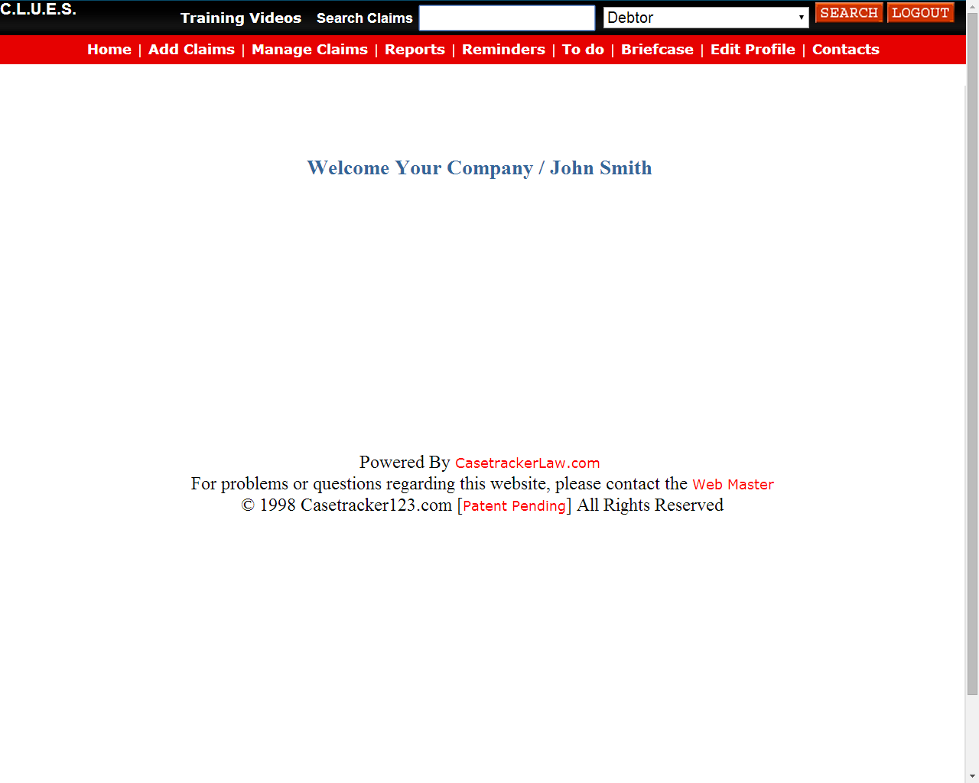

Slide 10
Step 1 - ADD CLAIMS

Slide 11
What do we want in your submission?
Any and all debtor contact info you have
Credit apps, signed personal guarantees, past due invoices, account statements, etc.
Email threads, if they show promises to pay or other background on your debtor
NOTES!! – summarize your experience with the debtor for us so that we’re fully armed to collect for you.

Slide 12
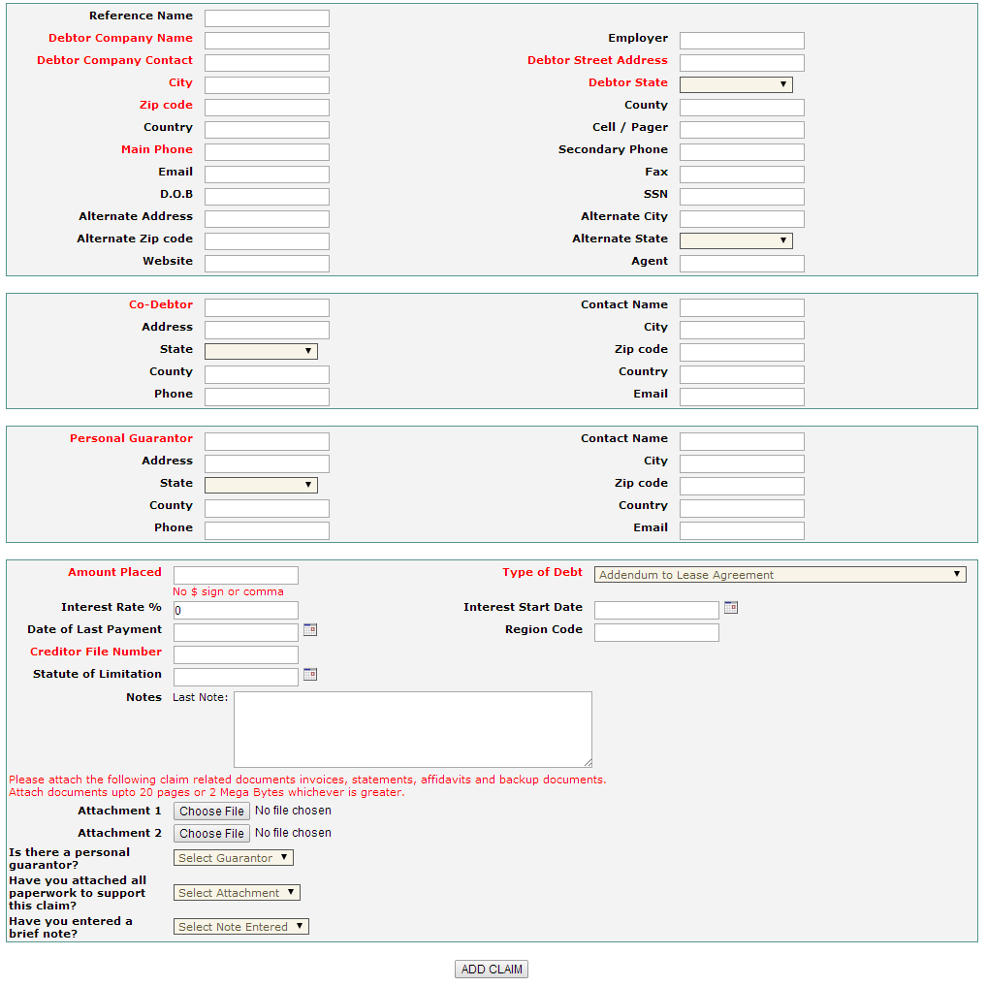
RED = Required (use an X, if no info)
BLACK = optional (but the more info, the better!)
Include Notes
Attach files
Drop-downs
Be sure to hit
ADD CLAIM

Slide 13
First 24-48 hours …
Step 2 – RESEARCH & DEMAND
Internal Auditor pulls LexisNexis reports on each account – showing assets, liens, judgments, alternate addresses, etc.
Auditor also reviews your paperwork, may request additional info.
Skiptracing, if necessary
Initial Demand letter sent to your debtor
Assigned to collector to start outreach

Slide 14
Step 3 – Collection Process
Collector places frequent calls to debtor, attempting to resolve matter swiftly
Sends additional demand letters, depending on conversations
Collection cycle generally lasts 45 days or so – by that time, we’ve either come to a resolution, or have determined that suit is warranted.

Slide 15
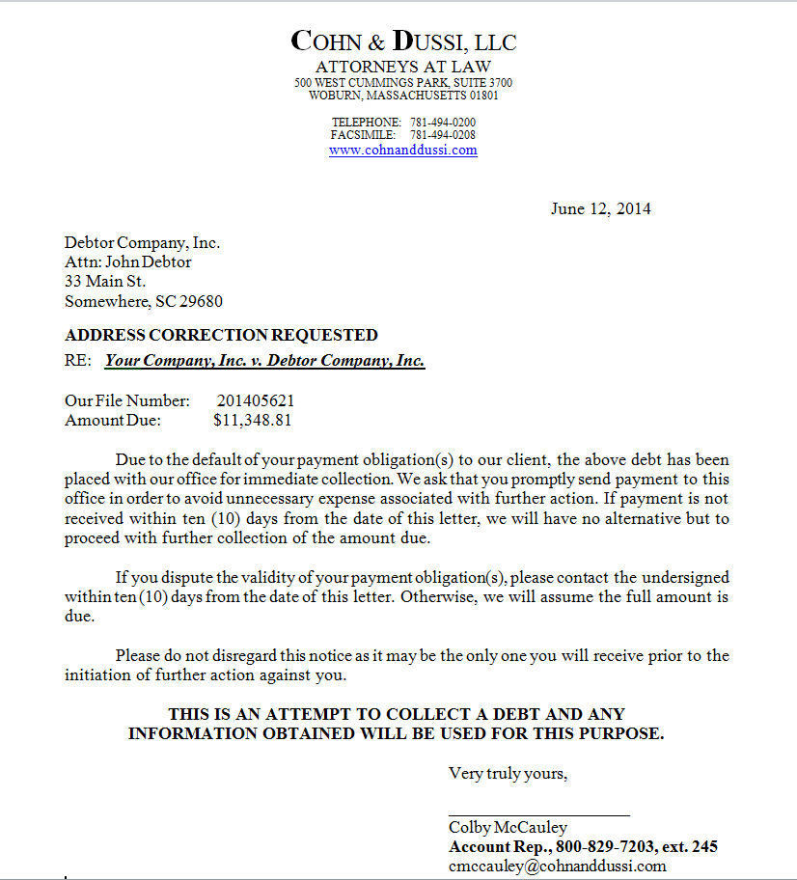
Sample Initial Demand Letter
C&D Letterhead
C&D Envelope

Slide 16
Step 4 – Litigation
In cases in which we are not successful, we can navigate any US court on your behalf.
MA, NH, & RI – Cohn & Dussi attorneys handle your case
Other 47 states – we turn to our national legal collaborative, assigning your case to an attorney within the debtor’s state
Our dedicated litigation managers ensure your case moves efficiently through the local courts, acting as the liasion between you and our attorneys

Slide 17
MANAGE CLAIMS – Where we prove our efforts on your accounts

Slide 18
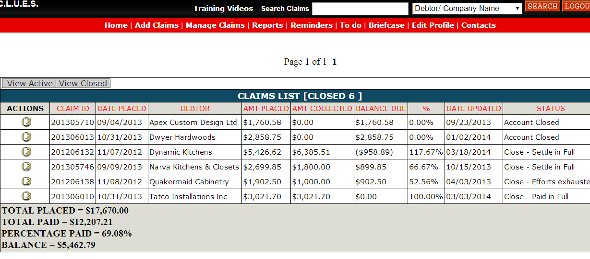
Claim List – view closed or open, click on “Actions” to dive in
View all activity in each claim (call summaries, emails, letters, diligence and research docs, etc.

Slide 19
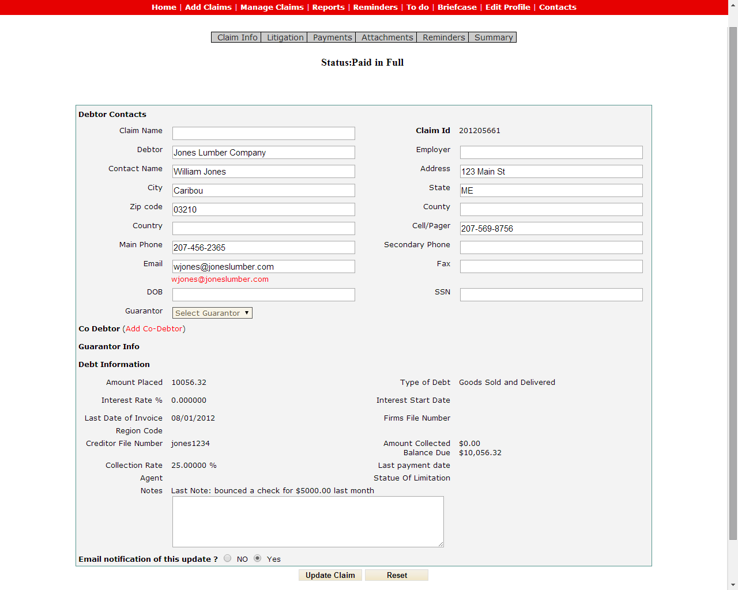
CLAIM INFO
Update us as we go!
Send notes to collectors

Slide 20
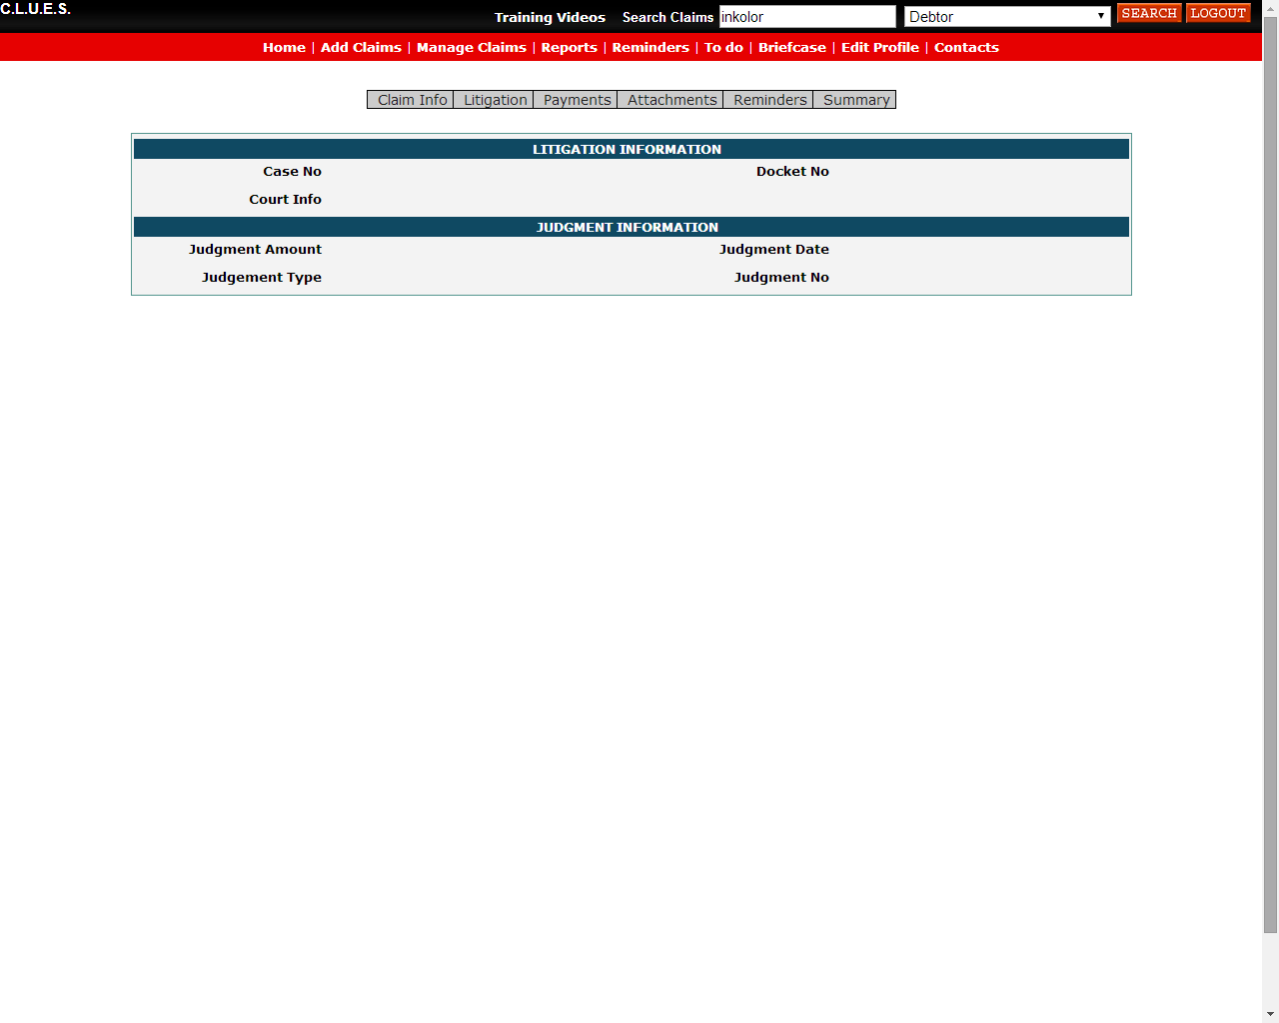
LITIGATION
Is your case in legal?
Quick reference on pertinent case info!

Slide 21
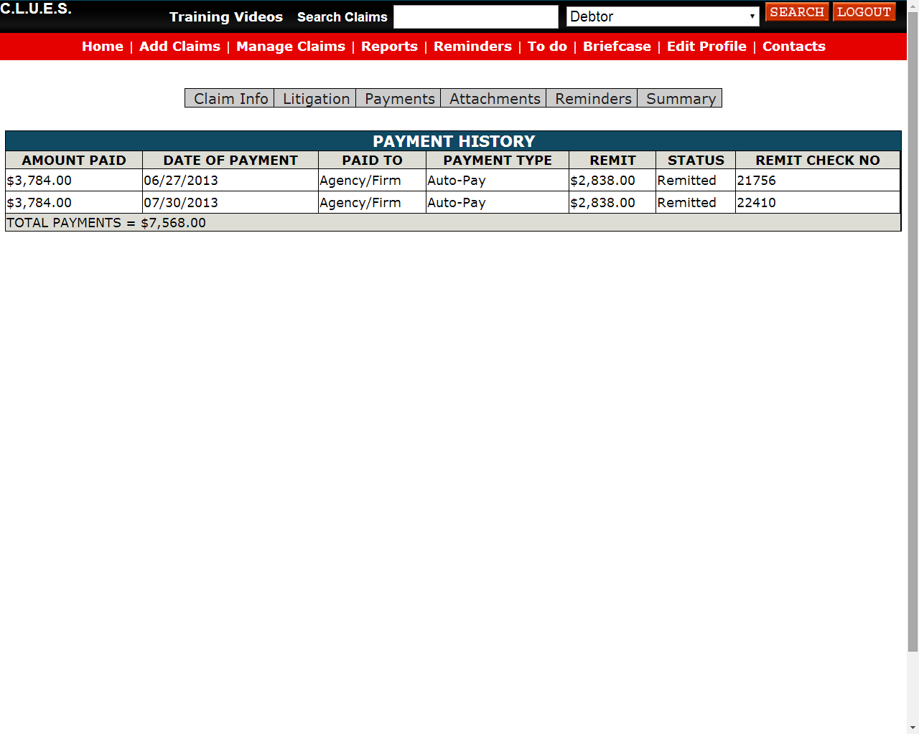
PAYMENTS
See all payments as they come in, and the remit status

Slide 22
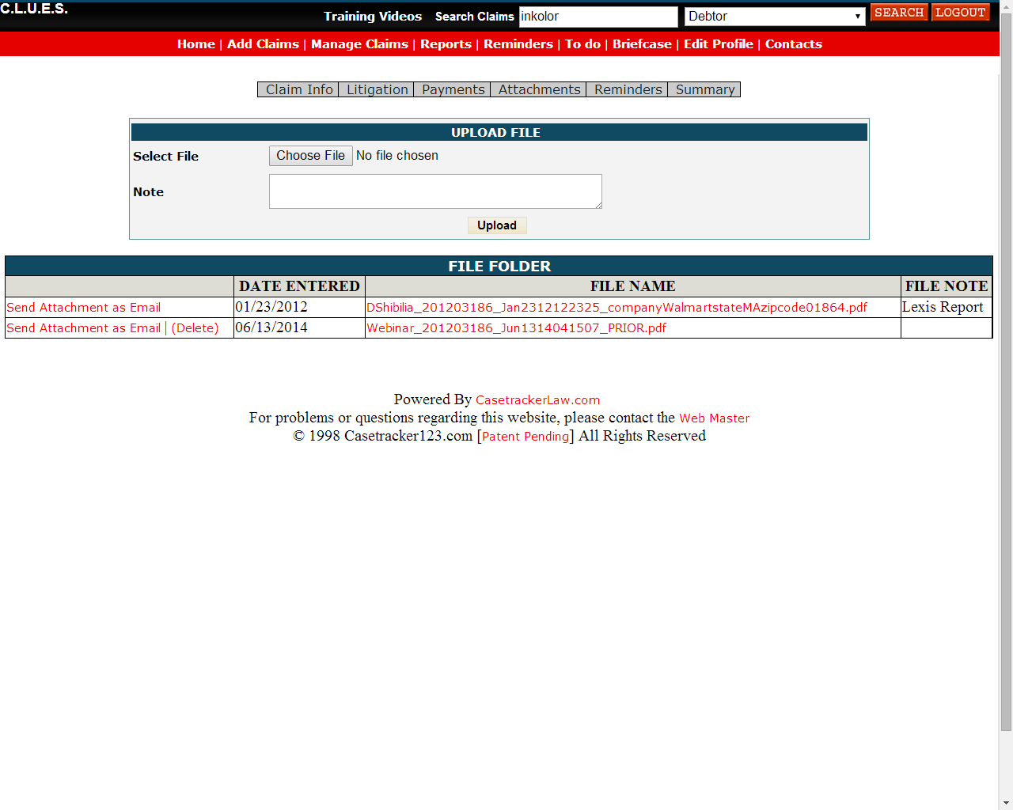
ATTACHMENTS
Forget to send us something?

Slide 23
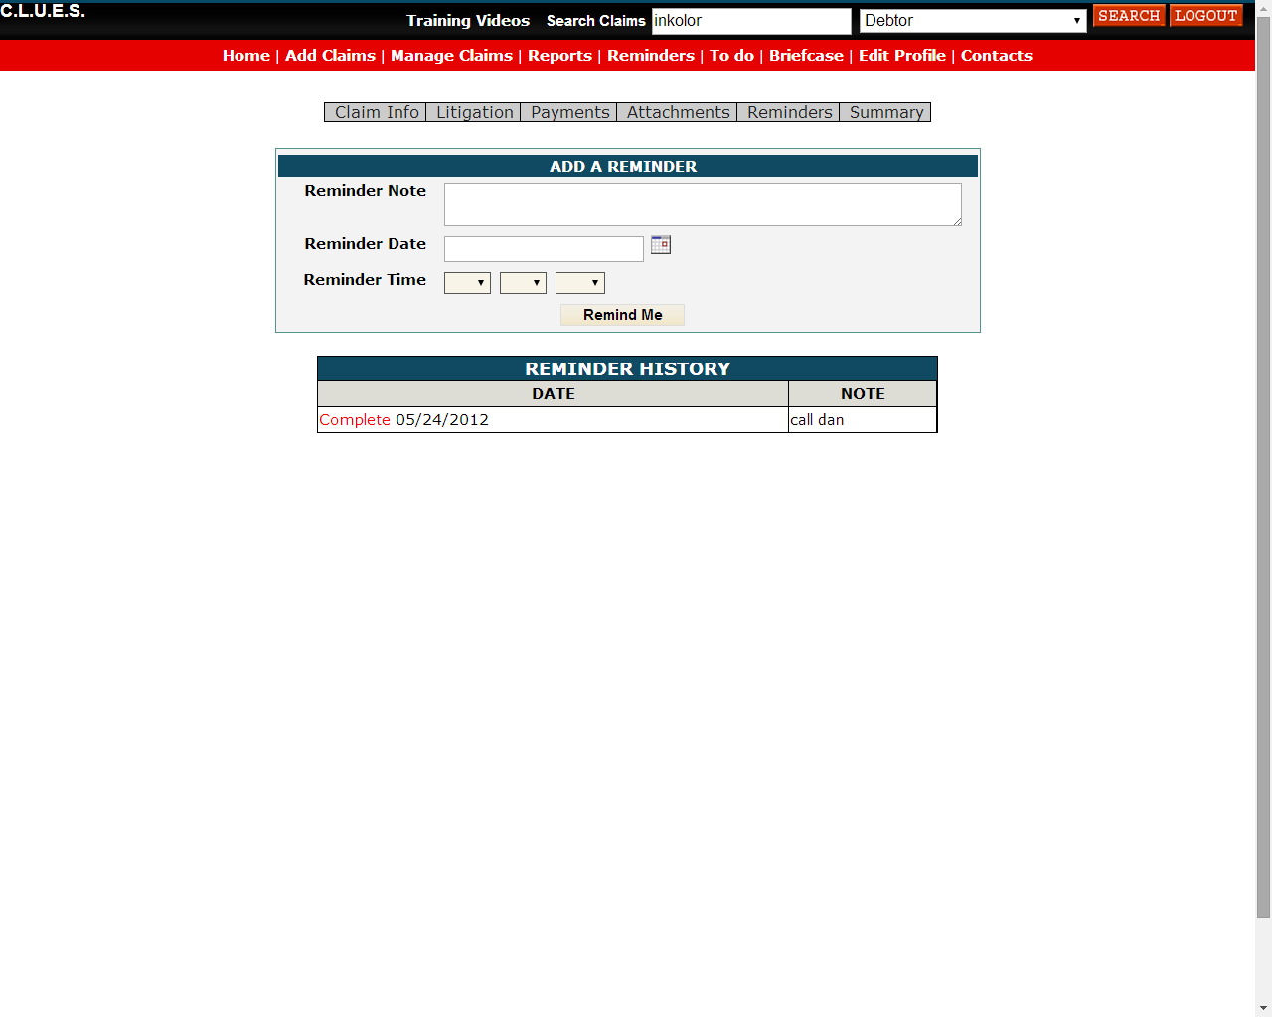
REMINDERS
Use this to follow up with us

Slide 24
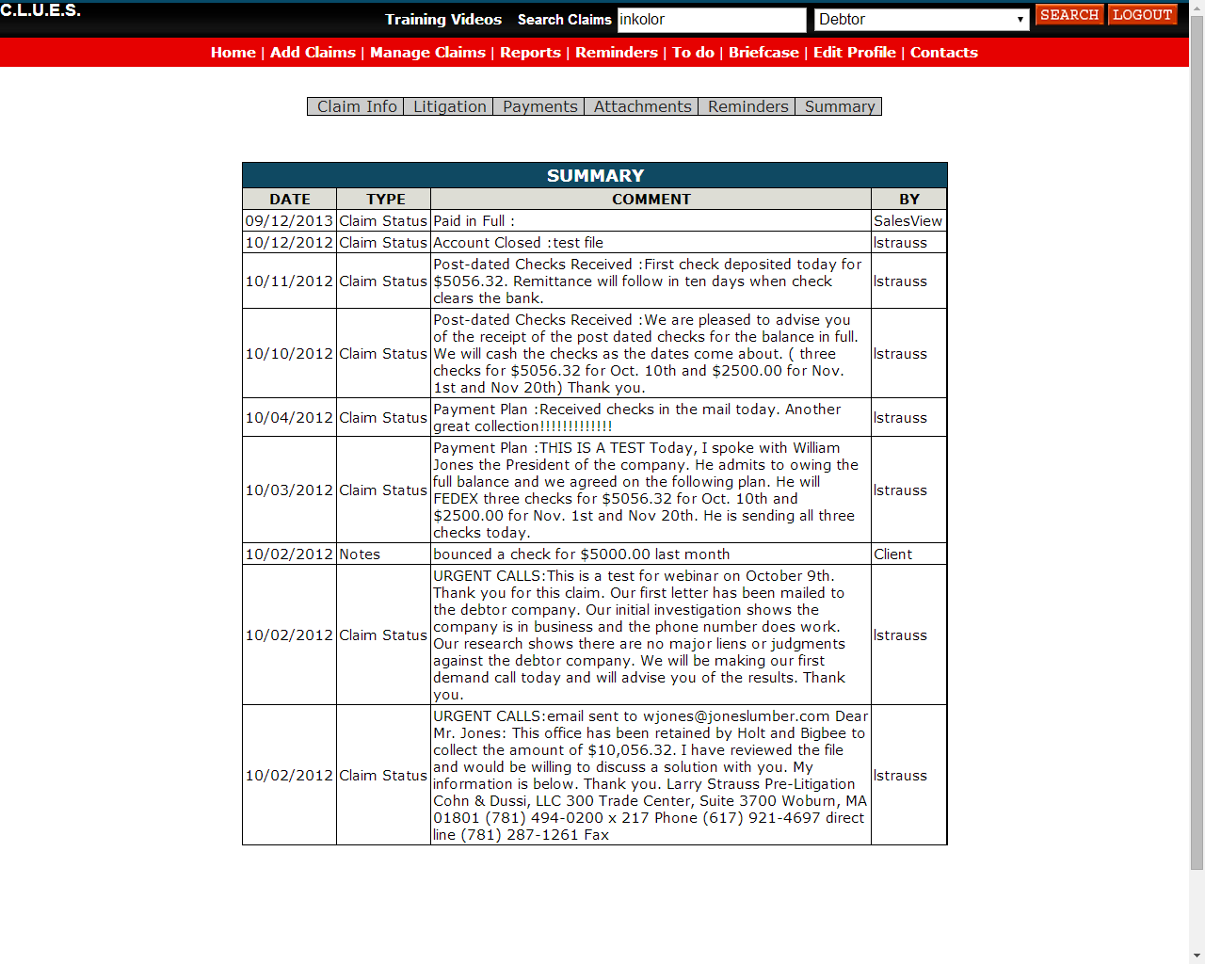
SUMMARY
Follow our progress in real time

Slide 25
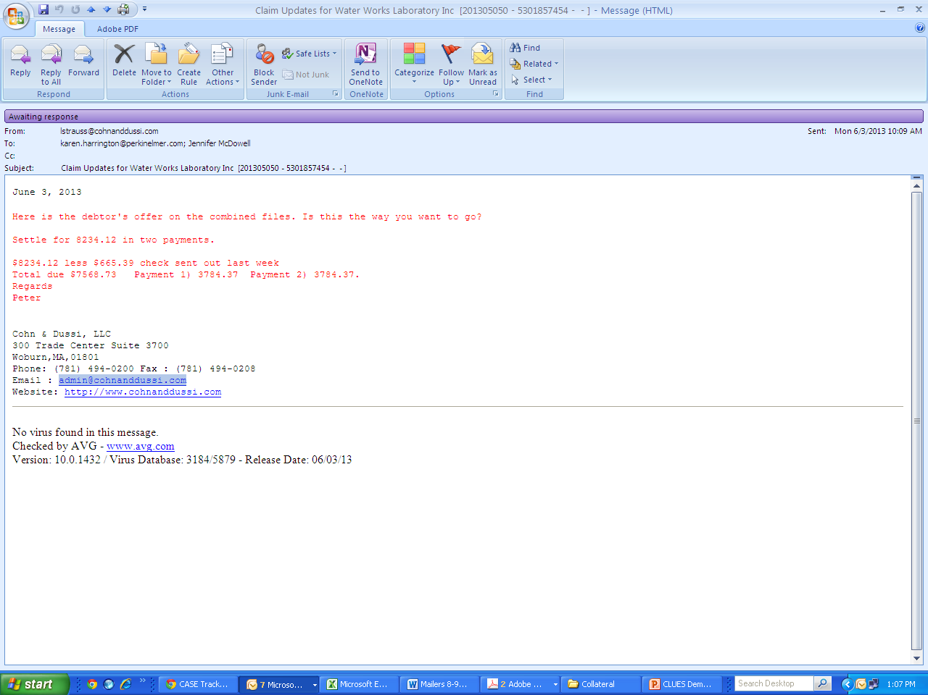
Email alerts from our team for significant movement (settlement offers, payment plans, etc.) – all tracked in the CLUES audit trail

Slide 26
VALUABLE REPORTS… all the info you need with just a few mouse clicks

Slide 27
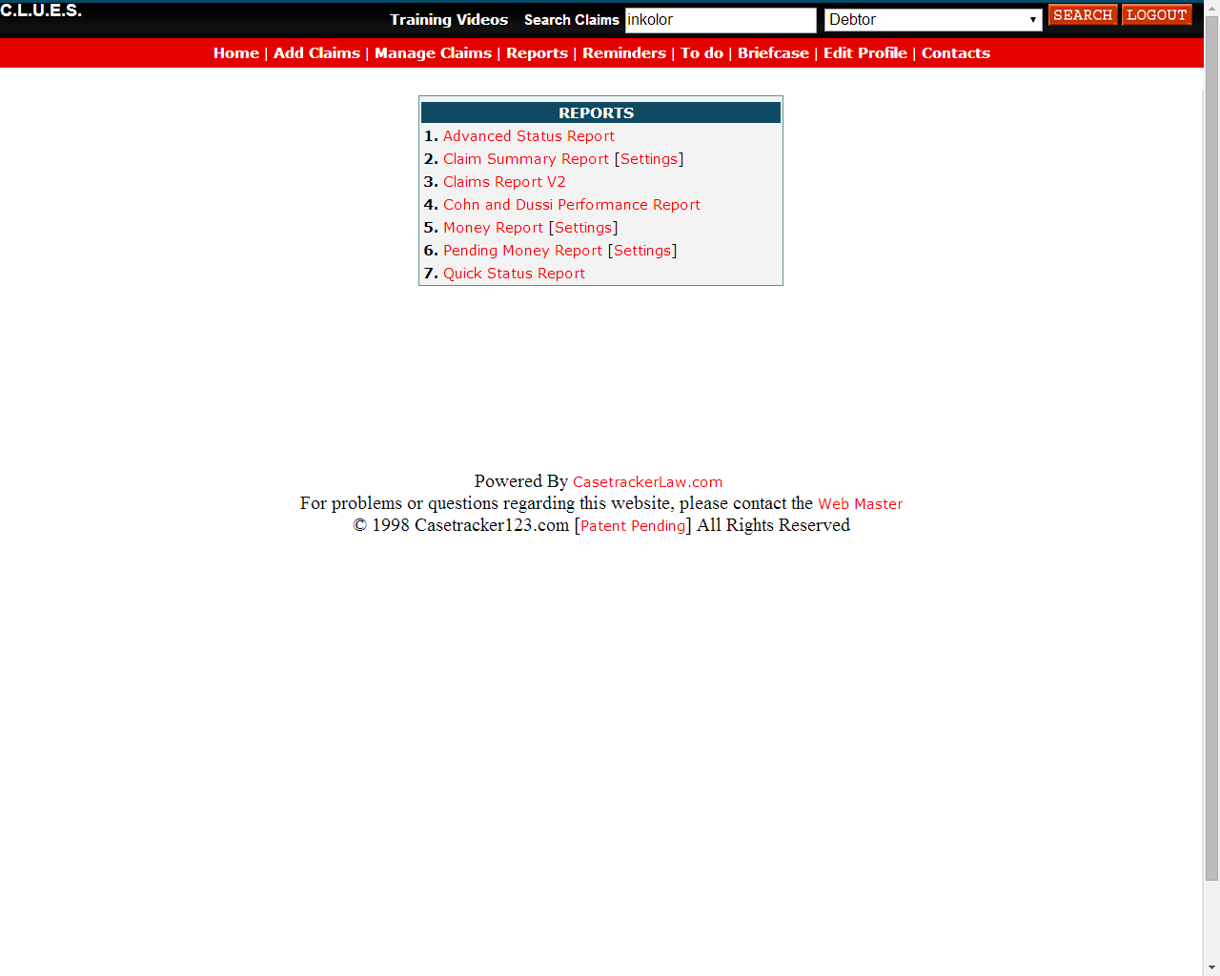
MOST USED REPORTS:
Claim Summary
Cohn & Dussi

Slide 28
CLAIM SUMMARY
Select your criteria,
“View Report” to generate
Download the report to Excel with one more click!

Slide 29
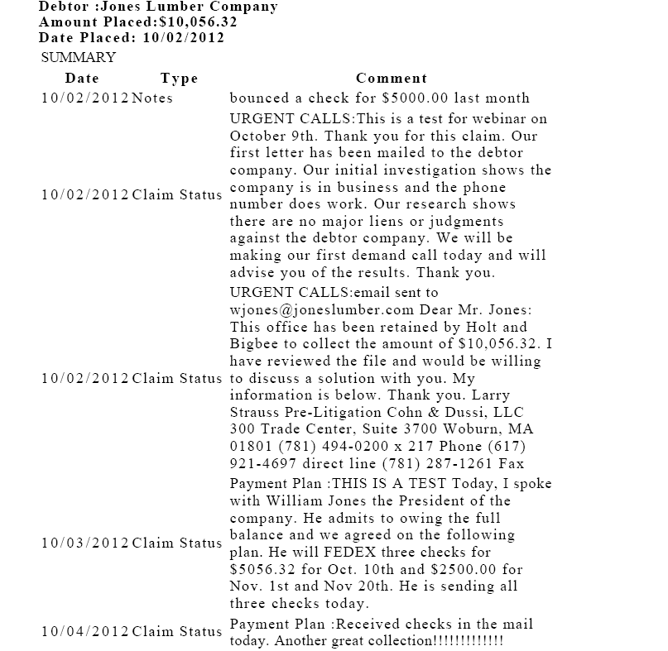
CLAIM SUMMARY
Select a claim, and click “Generate Summary” to export Claim Summary Audit Trail to PDF

Slide 30
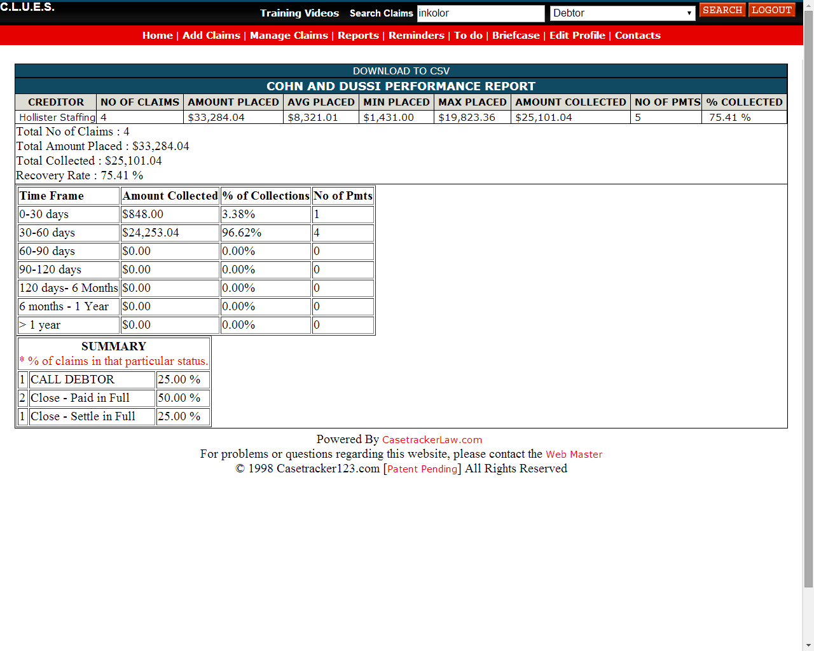
C&D PERFORMANCE
Our scorecard on your claims, also exportable

Slide 31
Thank you! To Get Started: Contact Allied National, Inc. 12020 Shamrock Road Suite 200 Omaha, NE 68154 800.456.5770 402.319.7654 mdavid@andc.com

